Slide 1

Tableau

Slide 2
Quick Overview
Introduction to Tableau
What is Data Visualization
Basic Concepts in Tableau
How does Tableau work?
Tableau Demo
Types of Connections - Demo
What is Tableau
Why Tableau
Tableau Products and Similar Products
Calculated Fields
Types of Connections
Filters
Sets
Grouping/Hierarchy
Parameter
Windows Function/Table Calculation
Dual Axis
Data Blending
Calculated Fields - Demo
Filters - Demo
Sets - Demo
Grouping/Hierarchy - Demo
Parameter - Demo
Windows Function/Table Calculation - Demo
Dual Axis - Demo
Data Blending - Demo
Dimensions vs Measures

Slide 3
Introduction to Tableau
What is Data Visualization?
Help people understand the significance of data by placing it in a visual context.
Notes:
Data visualization is a general term that describes any effort to help people understand the significance of data by placing it in a visual context. Patterns, trends and correlations that might go undetected in text-based data can be exposed and recognized easier with data visualization software.

Slide 4
Why Visualize ?
Visualization is any technique of creating images, diagrams, or animations to communicate a message and it has been an effective way to communicate both abstract and concrete ideas.
2015 | Delhi |  | Mumbai |  | Bangalore
Month | Price | Sales | Price | Sales | Price | Sales
Jan | 10.0 | 8.04 | 8.0 | 6.58 | 10 | 9.14
Feb | 8.0 | 6.95 | 8.0 | 5.76 | 8 | 8.14
Mar | 13.0 | 7.58 | 8.0 | 7.71 | 13 | 8.74
Apr | 9.0 | 8.81 | 8.0 | 8.84 | 9 | 8.77
May | 11.0 | 8.33 | 8.0 | 8.47 | 11 | 9.26
Jun | 14.0 | 9.96 | 8.0 | 7.04 | 14 | 8.1
Jul | 6.0 | 7.24 | 8.0 | 5.25 | 6 | 6.13
Aug | 4.0 | 4.26 | 19.0 | 12.5 | 4 | 3.1
Sep | 12.0 | 10.8 | 8.0 | 5.56 | 12 | 9.13
Oct | 7.0 | 4.82 | 8.0 | 7.91 | 7 | 7.26
Nov | 5.0 | 5.68 | 8.0 | 6.89 | 5 | 4.74
Average | 9 | 7.50 | 9 | 7.50 | 9 | 7.5
Variance | 10 | 3.75 | 10 | 3.75 | 10 | 3.75
Visualization helps to:
Analyze : Visual Comprehension is much faster than reading
Discover : Interactive visualizations lead to information discovery
Tell a Story : Great speaker use Visuals to make memorable story
Note : Average price & Variance is the same.

Slide 5
Comparison of Visualization tools
Tableau has the best rating due to its advanced visualizations capabilities, but something not solving for all BI needs.
Review |  | Tableau | Qlikview | Microstrategy | Oracle BI | SAP BI
Business criteria | Enterprise ready | 5 | 5 | 3 | 2 | 5
 | Usability | 5 | 5 | 4 | 2 | 5
 | Community | 5 | 4 | 2 | 2 | 2
Visualization criteria | Data interactivity | 4 | 5 | 3 | 2 | 3
 | Visual drilldown | 4 | 5 | 4 | 2 | 3
 | Dashboard support | 4 | 5 | 3 | 2 | 3
Technical criteria | Data integration | 5 | 4 | 4 | 5 | 5
 | Reporting capability | 4 | 5 | 5 | 3 | 3
Resources available | Talent and Training | 4 | 4 | 4 | 4 | 5
Analysts’ Review | Pros and cons | Easy to learn and use with large community but performance is poor with large datasets | Qlikview has the best advanced reporting capabilities but the support community is not as good as Tableau | Longest presence in the market but difficult to learn and implement | Rated at the bottom for nearly all customer user experience measures | Powerful parent company backing but visualization quality is not up to the mark
 | Final Review | Recommended | Recommended | Recommended | Not Recommended | Not Recommended
1: Poor | 2 : Average | 3 : Satisfactory | 4 : Good | 5 : Very good

Slide 6
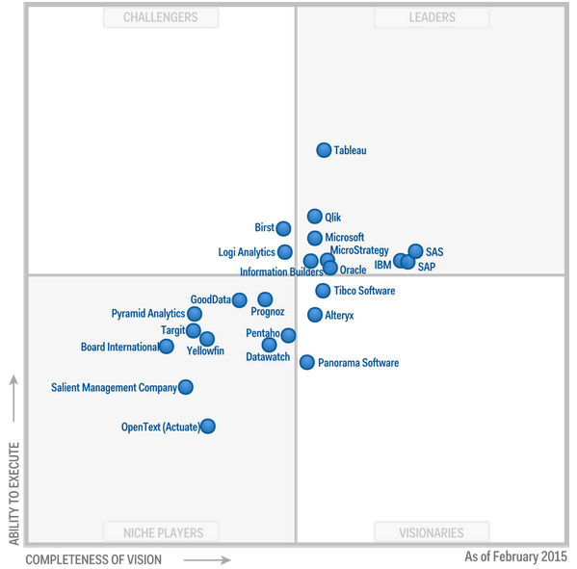
Why Tableau ?
Tableau is identified as optimal product in initial phase considering visual capabilities, client requirement, time to delivery and ease of use
Strengths | Cautions
Platform strength: Analytic dashboards, Easy to Use Fast Data Engine Cloud deployment Compatibility across multiple devices Market leader - Tableau customers report among the highest scores in terms of breadth and ease of use Very good support community R&D-driven company( % revenue -29% in 2014 ) | Limited data preparation and advanced Analytics capabilities. Third-party products and partner capabilities are generally required Being a high level software, limited functionalities are present.
Magic Quadrant for Business Intelligence and Analytics Platforms – Gartner 2015

Slide 7
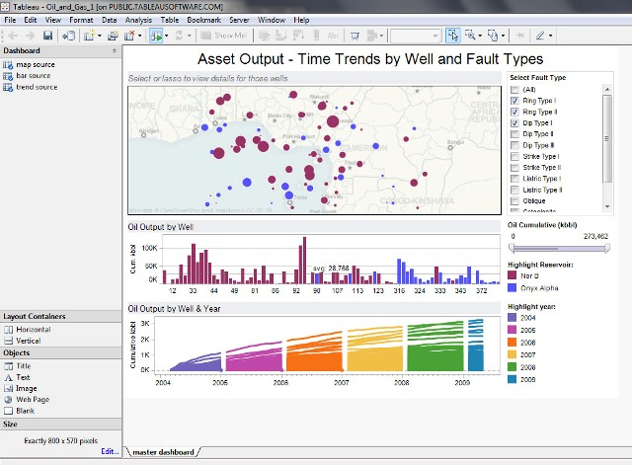
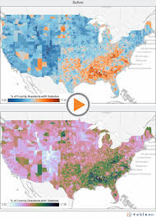
Sample Tableau dashboards

Slide 8
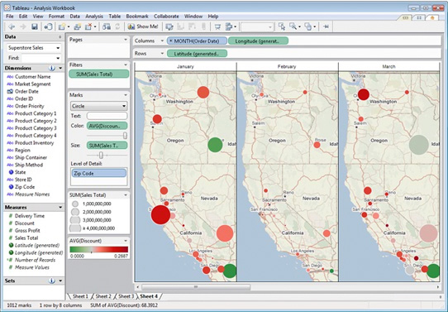
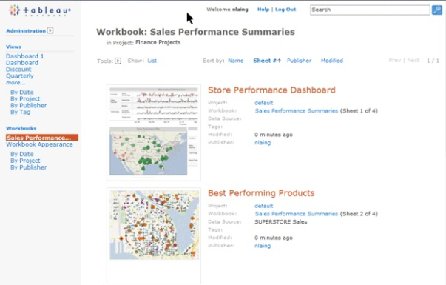
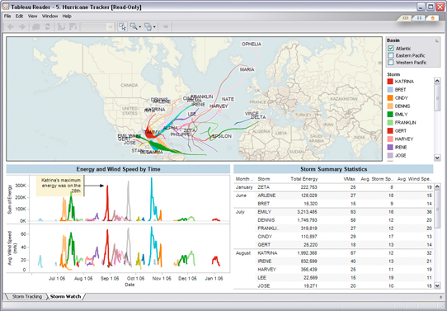
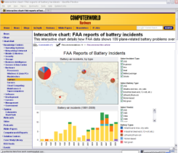
Tableau Products
Tableau Desktop
Create
Tableau Server
Share - Web
Tableau Reader
Share - Local
Tableau Public
Share - Everyone
ad hoc analytics, dashboards, reports, graphs
explore, visualize, and analyze your data
create dashboards to consolidate multiple views
deliver interactive data experiences
business intelligence solution scales to organizations of all sizes
share visual analytics with anyone with a web browser
publish interactive analytics or dashboards
secure information and manage metadata
collaborate with others
share visualizations & dashboards on the desktop
filter, sort, and page through the views
“Acrobat for Data”
free download
create and publish interactive visualizations and dashboards
embed in websites and blogs
free download and free hosting service
Notes:
Talk abt Tableau Online also

Slide 9
Steps to create the Tableau Dashboard
Prepare Data Source
Establish Connection with Tableau
Create sheets by using features
Put all these sheets in the dashboard
Improve the visual appeal

Slide 10
Types of Connections
Extract Connection
Live Connection
Notes:
Extract Connection: A connection with a static database, which is refreshed every day/hour/period. All data is copied from the data source to Tableau Server. Refreshing the data source will not give you the latest data - you have to refresh the extract to get these.
Live Connection: This will query the underlying data in the data source/database - refreshing the visualisation will give you the latest results. No data is copied to Tableau Server for pre-processing.

Slide 11
Use Cases of Connections
Live Connection | Extract Connection
Fast Database | Underlying data source is unacceptably slow.
Need up-to-the minute data(Real Time Updates) | Optimization of calculations and features
Data Size Huge | Access Offline
 | Portable Dashboard
Notes:
http://www.tableau.com/about/blog/2014/7/understanding-tableau-data-extracts-part1

Slide 12
Types of Connections – Business Scenarios
Use Case | Connections
Stock Data Analysis (Real Time) | Live
Seller Dashboard (Refresh at EOD) Flipkart | Extract (Refresh)
Digital Data (File/Data Source Size Huge) | Live
Campaign Results (Static Data Source – Refresh quarterly) | Extract

Slide 13
Types of Connections
Demo

Slide 14
Dimensions vs Measures
Dimensions are those columns in the data source which contain discrete categorical information .
Measures are those columns in the data source which contain quantitative, numerical information (that is, fields where the values are numbers).

Slide 15
Dimensions vs Measures - Example
Identify Dimension and Measure here.
State | Population
Jharkhand | 1000000
Bihar | 2000000
Uttar Pradesh | 3000000

Slide 16
Calculated Fields
Dimensions/Measures which are based on a formulae.
If our data source has Revenue and Cost, we can create a separate measure in Tableau for Profit = Revenue - Cost
Revenue | Cost | Profit
1000 | 800 | 200
1200 | 400 | 800

Slide 17
Calculated Fields
Demo

Slide 18
Filters
There are 3 filters –
Normal Filters
Action Filters
  Action Filters
  URL Filters
Context Filters

Slide 19
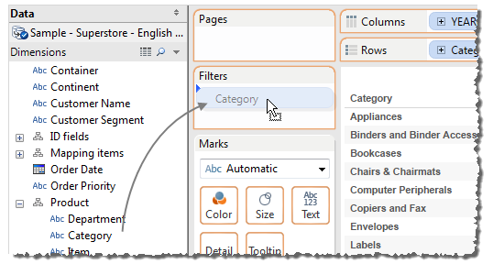
Filters – Normal Filters
Use for filtering data by using measure/dimension. This is a sheet level filter.

Slide 20
Filters – Normal Filters Demo
Demo

Slide 21
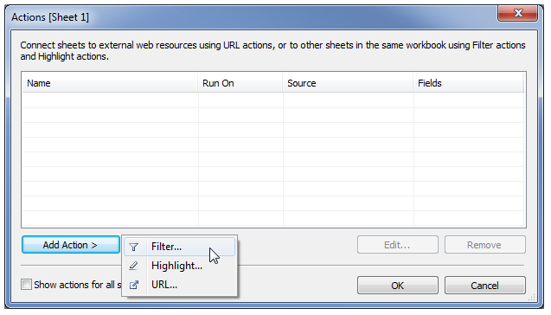
Filters – Action Filters
Use for drill-down filtering across sheets.

Slide 22
Filters – Action Filters Demo
Demo

Slide 23
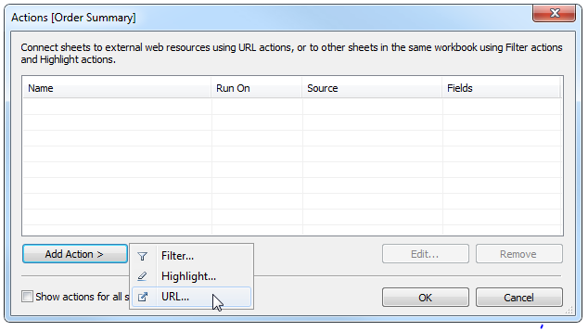
Filters – URL Filters
A URL action is a hyperlink that points to a Web page, file, or other web-based resource outside of Tableau.

Slide 24
Filters – URL Filters Demo
Demo

Slide 25
Filters – Context Filters
By default, all filters that you set in Tableau are computed independently.
A context filter is treated as independent filter. But, any other filters that you set are defined as dependent filters because they process only the data that passes through the context filter.
Notes:
You may create a context filter to:
Improve performance – If you set a lot of filters or have a large data source, the queries can be slow. You can set one or more context filters to improve performance.
Create a dependent numerical or top N filter – You can set a context filter to include only the data of interest, and then set a numerical or a top N filter.

Slide 26
Filters – Context Filters Demo
Demo

Slide 27
Sets
Sets are custom fields that define a subset of data based on some conditions. A set can be based on a computed condition, for example, a set may contain customers with sales over a certain threshold.
Find the “set”(list) of batsmen who have scored at least 15000 runs.
Batsmen | Runs
Sachin Tendulkar | 21700
Rahul Dravid | 15000
AB de Villiers | 8500
Chris Gayle | 7500
Alaistar Cook | 10200
Virat Kohli | 12000
Faf Du Plessis | 7000

Slide 28
Sets - Demo
Demo

Slide 29
Grouping/Hierarchy
A group is a combination of dimension members that make higher level categories.
For example, if you are working with a view that shows average test scores by major, you may want to group certain majors together to create major categories. English and History may be combined into a group called Liberal Arts while Biology and Physics may be grouped as Science Majors.

Slide 30
Grouping/Hierarchy - Demo
Demo

Slide 31
Parameters
Parameters are dynamic values that can replace constant values in calculations, filters, and reference lines.

Slide 32
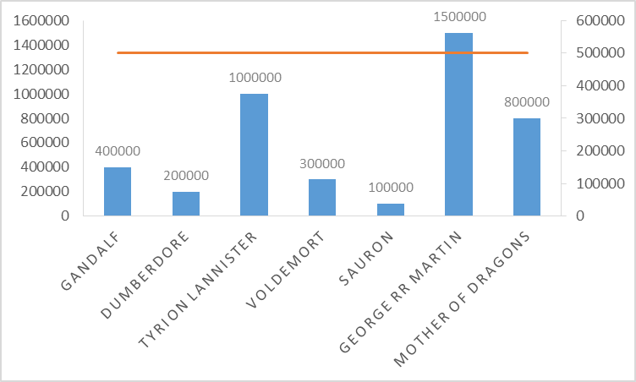
Parameters
What if we need to dynamically change Reference Line?
Customer | Revenue | Reference Revenue
Gandalf | 400000 | 500000
Dumberdore | 200000 | 500000
Tyrion Lannister | 1000000 | 500000
Voldemort | 300000 | 500000
Sauron | 100000 | 500000
George RR Martin | 1500000 | 500000
Mother of Dragons | 800000 | 500000

Slide 33
Parameters - Demo
Demo

Slide 34
Dual Axis
To visualize 2 independent values having different scales simultaneously in a graph.
The Synchronize Axis option ensures that you make a scaled and correct comparison. However, sometimes this option may not be available (grayed out). This is because the data type of one of the axes is different from the other.

Slide 35
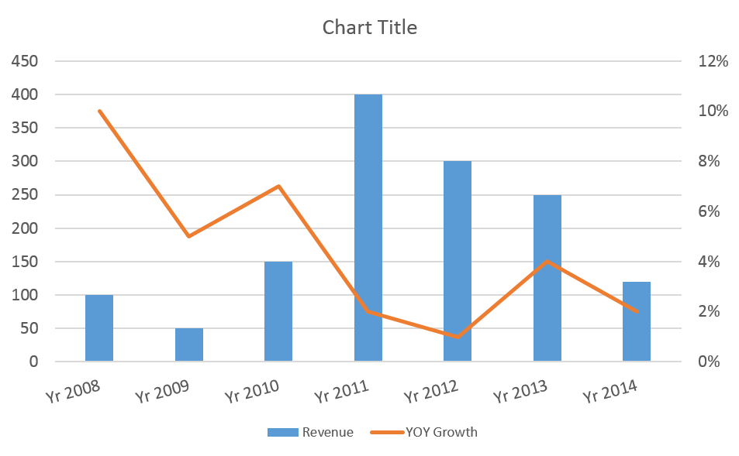
Dual Axis
Year | Revenue | YOY Growth
Yr 2008 | 100 | 10%
Yr 2009 | 50 | 5%
Yr 2010 | 150 | 7%
Yr 2011 | 400 | 2%
Yr 2012 | 300 | 1%
Yr 2013 | 250 | 4%
Yr 2014 | 120 | 2%
How to recreate this in tableau?

Slide 36
Dual Axis - Demo
Demo

Slide 37
Windows Functions/Table Calculations
This functions operate on the window as a whole rather than row level calculation which tableau generally does.
Important thing to understand first–
Addressing and Partitioning

Slide 38
Addressing and Partitioning
Table calculations are performed on a single measure in the view.
The dimensions that define the part of the table you are applying the calculation to (computing along) are called addressing fields. It defines the “direction of calculation”.
The dimensions that define how to group the calculation are called partitioning fields. It defines “scope of calculation”

Slide 39
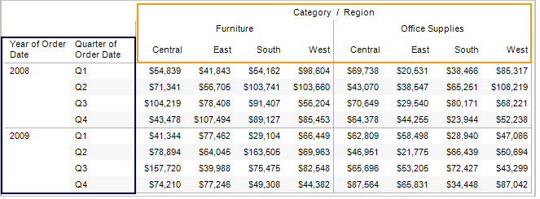
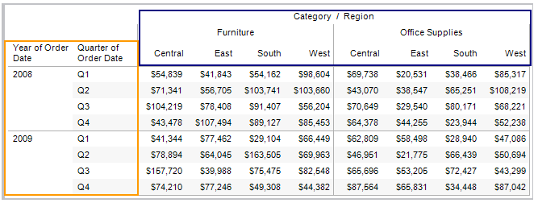
Common Addressing and Partitioning
Table (Across) –
Table (Down) -
Addressing Field
Partitioning Fields

Slide 40
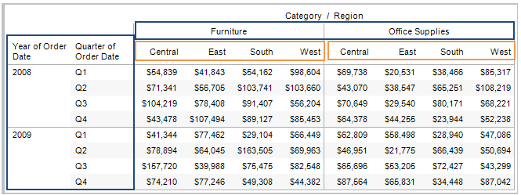
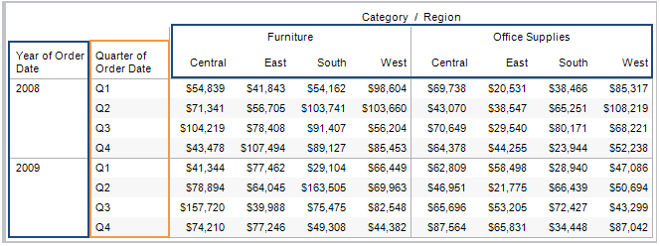
Common Addressing and Partitioning
Pane (Across) -
Pane (Down) -
Addressing Field
Partitioning Fields

Slide 41
Common Table Calculations
Difference From - Use this type of calculation to compute the difference between two specified values in the table along a certain dimension.
For example, computing YOY difference in sales for a store.
Country | Revenue | YOY Difference
Yr 2008 | 100 | 100
Yr 2009 | 50 | -50
Yr 2010 | 150 | 100
Yr 2011 | 400 | 250
Yr 2012 | 300 | -100
Yr 2013 | 250 | -50
Yr 2014 | 120 | -130

Slide 42
Common Table Calculations - Demo
Demo

Slide 43
Common Table Calculations
Percent Difference - Use this type of calculation to display the rate of change between two specified values in the table by computing the difference as a percentage.
For example, computing YOY % Change in sales for a store.
Country | Revenue | YOY % Chng.
Yr 2008 | 100
Yr 2009 | 50 | -50%
Yr 2010 | 150 | 200%
Yr 2011 | 400 | 167%
Yr 2012 | 300 | -25%
Yr 2013 | 250 | -17%
Yr 2014 | 120 | -52%

Slide 44
Common Table Calculations - Demo
Demo

Slide 45
Common Table Calculations
Percent of Total - When you select Percentage of Table, each measure on the worksheet is expressed as a percentage of the total for the entire worksheet (table).
For example, computing % of Total Revenue for each year.
Country | Revenue | % of Total Revenue
Yr 2008 | 100 | 7%
Yr 2009 | 50 | 4%
Yr 2010 | 150 | 11%
Yr 2011 | 400 | 29%
Yr 2012 | 300 | 22%
Yr 2013 | 250 | 18%
Yr 2014 | 120 | 9%
Total | 1370 | 100%

Slide 46
Common Table Calculations - Demo
Demo

Slide 47
Common Table Calculations
Running Total - Use the Running Total calculation to compute a cumulative total across a dimension or table structure.
For eg. Cumulative sale of Revenue of a store.
Country | Revenue | Cumulative Revenue
Yr 2008 | 100 | 100
Yr 2009 | 50 | 150
Yr 2010 | 150 | 300
Yr 2011 | 400 | 700
Yr 2012 | 300 | 1000
Yr 2013 | 250 | 1250
Yr 2014 | 120 | 1370

Slide 48
Common Table Calculations - Demo
Demo

Slide 49
Common Windows Functions
Windows_Sum() - Returns the sum of the expression within the window. The window is defined by means of offsets from the current row.
Windows_Max() - Returns the maximum of the expression within the window. The window is defined by means of offsets from the current row.

Slide 50
Common Windows Functions - Demo
Demo

Slide 51
Data Blending
Data blending is when you combine data from multiple data source types in a single worksheet. The data is joined on common dimensions.
Data Blending does not create row level joins and is not a way to add new dimensions or rows to your data.
Notes:
For example, you may have Sales data collected in an Oracle database and Sales Goal data in an Excel spreadsheet. To compare actual sales to target sales, you can blend the data based on common dimensions to get access to the Sales Goal measure.

Slide 52
Data Blending - Demo
Demo

Slide 53

Thank You

